Slide 1
Item Response Theory Models for Dichotomously Scored Item Responses (The Lord-Birnbaum Tradition)
EDUC 8720

Slide 2
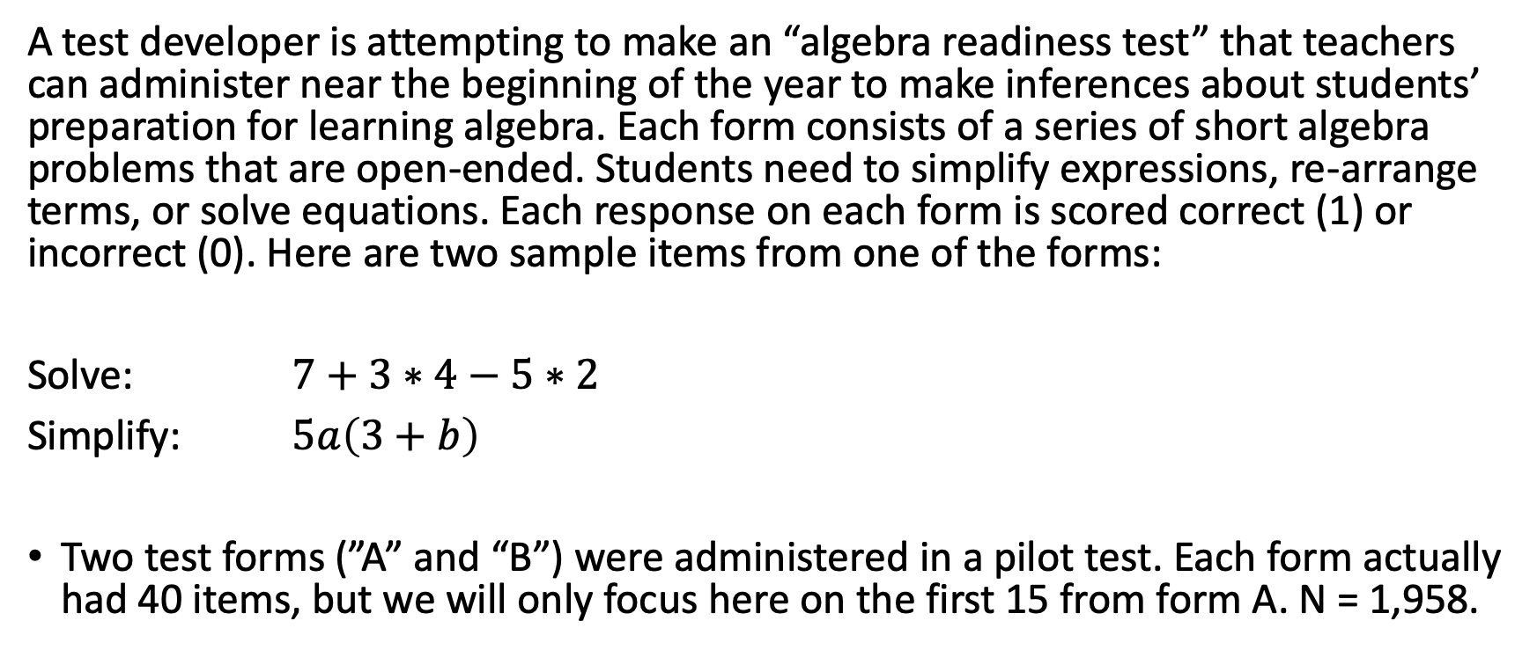
Some Motivating Data
A test developer is attempting to make an “algebra readiness test” that teachers can administer near the beginning of the year to make inferences about students’ preparation for learning algebra. Each form consists of a series of short algebra problems that are open-ended. Students need to simplify expressions, re-arrange terms, or solve equations. Each response on each form is scored correct (1) or incorrect (0). Here are two sample items from one of the forms:
Solve: $7+3∗4−5∗2$
Simplify: $5a\left(3+b\right)$
Two test forms (”A” and “B”) were administered in a pilot test. Each form actually had 40 items, but we will only focus here on the first 15 from form A. N = 1,958.

Slide 3
Warm-Up Activity
Download the file “pset1_formA.csv”
Open the R script file “lb_irt_013122.r”
Follow along by running the commands in “PART 1”
Use the function alpha from the package psych to examine the classical item statistics.
Next, create item characteristic curve plots for the Form A data.
Use the total score as the x-axis variable.
Do you think an IRT model will fit these data? If so, which one and why? If not, why not?

Slide 4
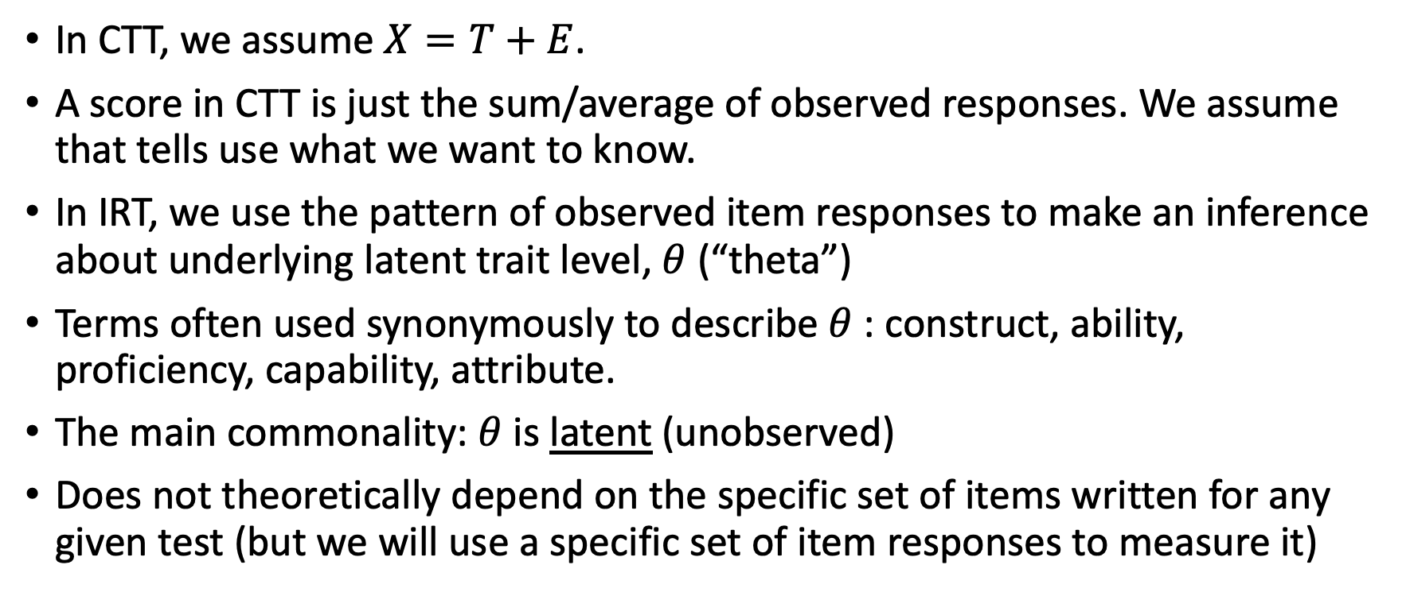
Scores in CTT vs. IRT
In CTT, we assume $X=T+E$.
A score in CTT is just the sum/average of observed responses. We assume that tells use what we want to know.
In IRT, we use the pattern of observed item responses to make an inference about underlying latent trait level, $θ$ (“theta”)
Terms often used synonymously to describe $θ$: construct, ability, proficiency, capability, attribute.
The main commonality: $θ$ is latent (unobserved)
Does not theoretically depend on the specific set of items written for any given test (but we will use a specific set of item responses to measure it)

Slide 5
Outline of Slides that Follow
Lord’s Derivation of the 2PNO Item Response Function
Logistic vs. Normal Distributions
Interpreting ICCs for 1/2/3PL IRT Models
IRT Model Assumptions and Properties
Using mirt package with motivating data
Optional Practice: Calculating Probabilities from ICCs
Test Characteristic Curves
Test and Item Information

Slide 6
Using the Normal Ogive to Derive an Item Characteristic Curve
This section represents an elaboration/illustration of the narrative found in Lord & Novick (1968, pp. 370-371) and in Thissen & Orlando (2001, pp. 84-87).

Slide 7
Lord & Novick (1968)
In their classic book, L&N introduce the normal ogive IRT model as
They write:
[The equation] may be taken simply as a basic assumption, the utility of which can be investigated for a given set of data (albeit with considerable difficulty). Alternatively [this equation] can be inferred from other, possibly more plausible assumptions. We shall outline one way of doing this, a way that some theorists find interesting and others do not. (Lord & Novick, 1968, p. 370)

Slide 8
It Starts with a Test and an Item
Let’s say the first item on a math test for 6th graders asks
A penny is tossed 20 times. Which of the following is most likely to be the number of times heads came up?
A. 0
B. 2
C. 5
D. 8
E. 15
This item is trying to find out whether the student has a basic understanding of probability.

Slide 9
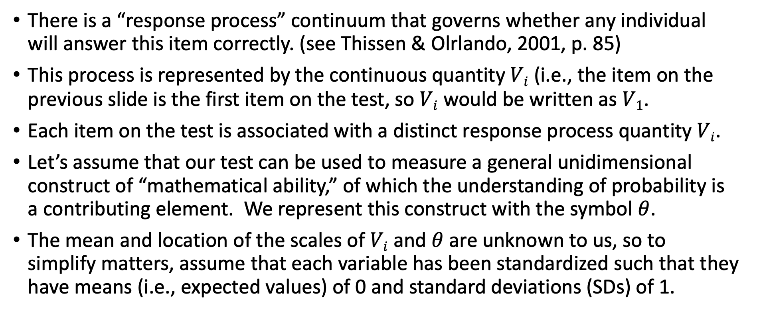
Now Build a Model
There is a “response process” continuum that governs whether any individual will answer this item correctly. (see Thissen & Olrlando, 2001, p. 85)
This process is represented by the continuous quantity $Vi$ (i.e., the item on the previous slide is the first item on the test, so $Vi$ would be written as $V1$.
Each item on the test is associated with a distinct response process quantity $Vi$.
Let’s assume that our test can be used to measure a general unidimensional construct of “mathematical ability,” of which the understanding of probability is a contributing element. We represent this construct with the symbol $θ$.
The mean and location of the scales of $Vi$ and $θ$ are unknown to us, so to simplify matters, assume that each variable has been standardized such that they have means (i.e., expected values) of 0 and standard deviations (SDs) of 1.

Slide 10
A Regression Equation
The latent variable underying any single item on the test can be related with the linear regression equation
where ρ_{i} represents the correlation between V_{i} and θ (recall that the slope of a regression of one standardized variable onto the other is just the correlation coefficient); and ε_{i} represents a random error term.
We assume that ε_{i} ~ N(0, 1), and by construction (just as in CTT!), the latent variables ε_{i} and θ are independent.
The parameter ρ_{i} represents a biserial correlation (as opposed to a point-biserial correlation).

Slide 11
A (Hypothetical) Visualization for 500 students on item 1 when ρ₁ = 0.70

Slide 12
Notes
The regression line predicts the conditional mean of V_{i} given θ. An equivalent way to write this would be
The amount that any single prediction is likely to be off for any given respondent is quantified by the root mean square error (RMSE), which will be
The pdf for V_{i} given θ is assumed to be normally distributed (no such assumption is needed for unconditional distributions of V_{i} or θ)

Slide 13

Item with a Threshold at $Vi =τ_{i}=1$
How would we figure out the probability of someone having V_{i} over 1 for different values of θ?
Notes:
This is how I generated the data for this plot in R:
library(MASS)
sigma<-matrix(c(1,.7,.7,1),2,2)
mu<-c(0,0)
bvn <- mvrnorm(n=500, mu = mu, Sigma = sigma )
plot(bvn,xlim=c(-3,3),ylim=c(-3,4),xlab="Theta",ylab="V")
abline(h=1,col="red")

Slide 14
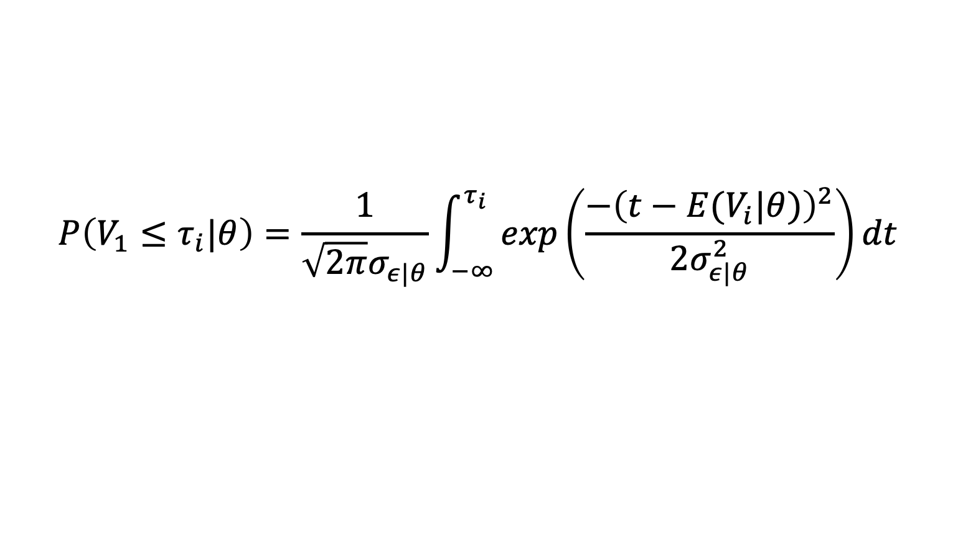

Use the Normal Cumulative Distribution Function (CDF)
$$P\left(V_{1}≤τ_{i}|θ\right)=\frac{1}{\sqrt{2π}σ_{ε|θ}}\int_{−∞}^{τ_{i}}{exp\left(\frac{−{\left(t−E(V_{i}|θ)\right)}^{2}}{2σ_{ε|θ}^{2}}\right)}dt$$
Notice that this is a conditional cdf (give you a probability conditional on a specific value of $θ$
If you are not familiar with the normal cdf (also known as the normal ogive) and want to understasnd it better, please see http://www.r-bloggers.com/normal-distribution-functions/ which shows how you can use it in R, and also see my ppt slides “2_Background_Statistical_Concepts.pptx”

Slide 15

When $θ=−1$
So if you plug these values into the cdf on previous page it follows that
$$P\left(V_{1}>1\right|θ=−1)=1−P(V_{1}≤1\left|θ=−1\right)=.01$$
> 1-pnorm(1, mean=-.7, sd=.71)
[1] 0.008324558

Slide 16

$P(V≥1)$ when $θ$ $= −1$ $is .01$

Slide 17

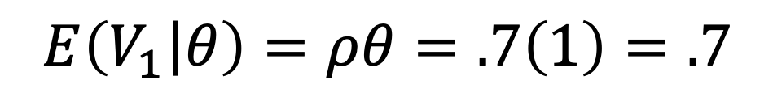
What about when $θ =1$?
$$E\left(V_{1} | θ\right)=ρθ=.7\left(1\right)=.7$$
So if you plug these values into the cdf on previous page it follows that
P$\left(V_{1}>1 | θ=1\right)=1−P\left(V_{1}≤1 | θ=1 \right)=.34$
1-pnorm(1, mean=.7, sd=.71)
[1] 0.3363172

Slide 18

$P(V>1)$ when $θ=1$is .34

Slide 19

What about when $θ = 2$?
So if you plug these values into the cdf on previous page it follows that
> 1-pnorm(1, mean=1.4, sd=.71)
[1] 0.713412

Slide 20

$P(V>1)$ when $θ=2$ is .72

Slide 21
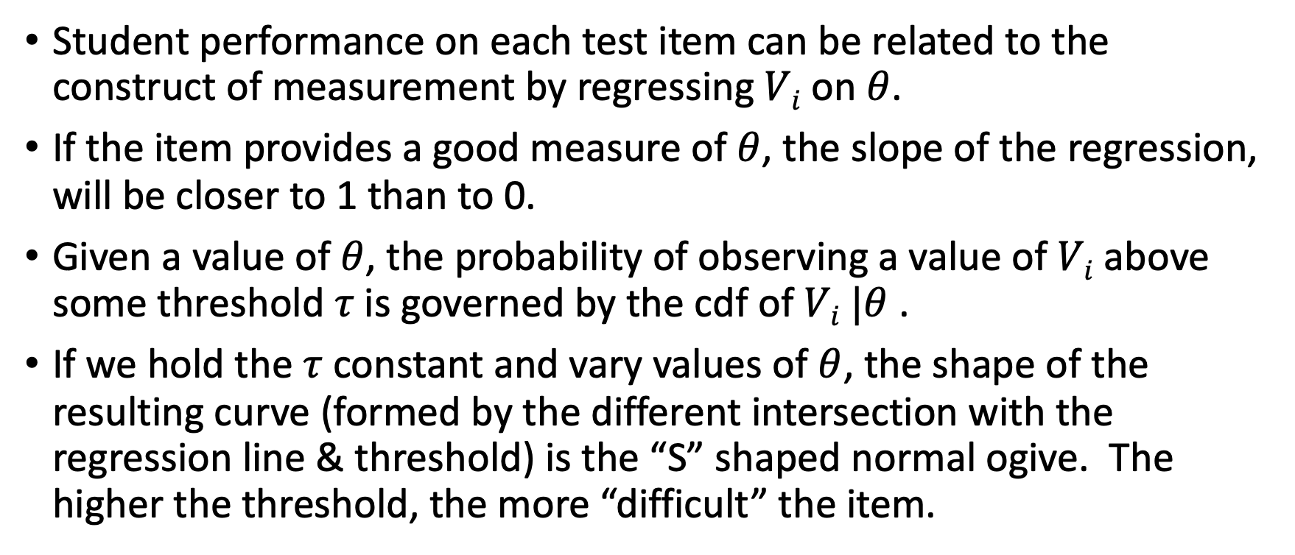
The Story So Far
Student performance on each test item can be related to the construct of measurement by regressing $Vi$ on $θ$.
If the item provides a good measure of $θ$, the slope of the regression, will be closer to 1 than to 0.
Given a value of $θ$, the probability of observing a value of $Vi$ above some threshold $τ$is governed by the cdf of $Vi |θ$ .
If we hold the $τ$ constant and vary values of $θ$, the shape of the resulting curve (formed by the different intersection with the regression line & threshold) is the “S” shaped normal ogive. The higher the threshold, the more “difficult” the item.

Slide 22
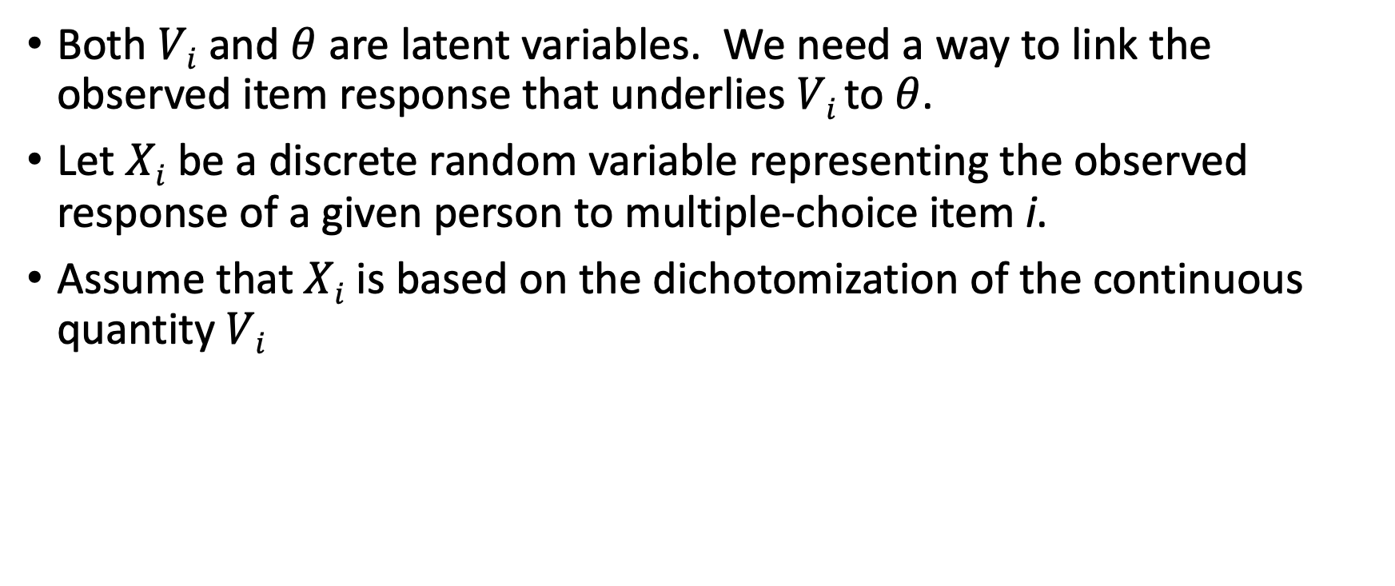
From Latent to Observed
Both $Vi$ and $θ$ are latent variables. We need a way to link the observed item response that underlies $Vi$ to $θ$.
Let $Xi$ be a discrete random variable representing the observed response of a given person to multiple-choice item i.
Assume that $Xi$ is based on the dichotomization of the continuous quantity $Vi$

Slide 23
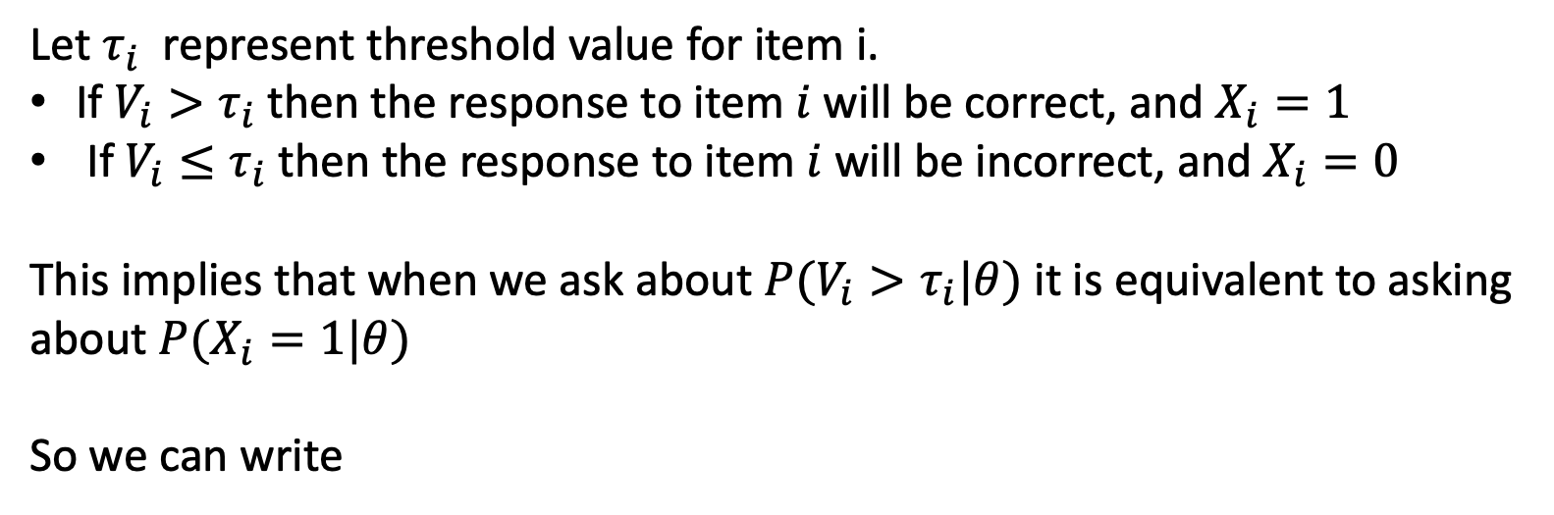
Dichotomization Rule
Let $τ_{i}$ represent threshold value for item i.
If $V_{i}>τ_{i}$then the response to item $i$ will be correct, and $X_{i}=1$
If $V_{i}≤τ_{i}$then the response to item $i$ will be incorrect, and $X_{i}=0$
This implies that when we ask about $P(V_{i}>τ_{i}|θ)$ it is equivalent to asking about $P(X_{i}=1|θ)$
So we can write

Slide 24
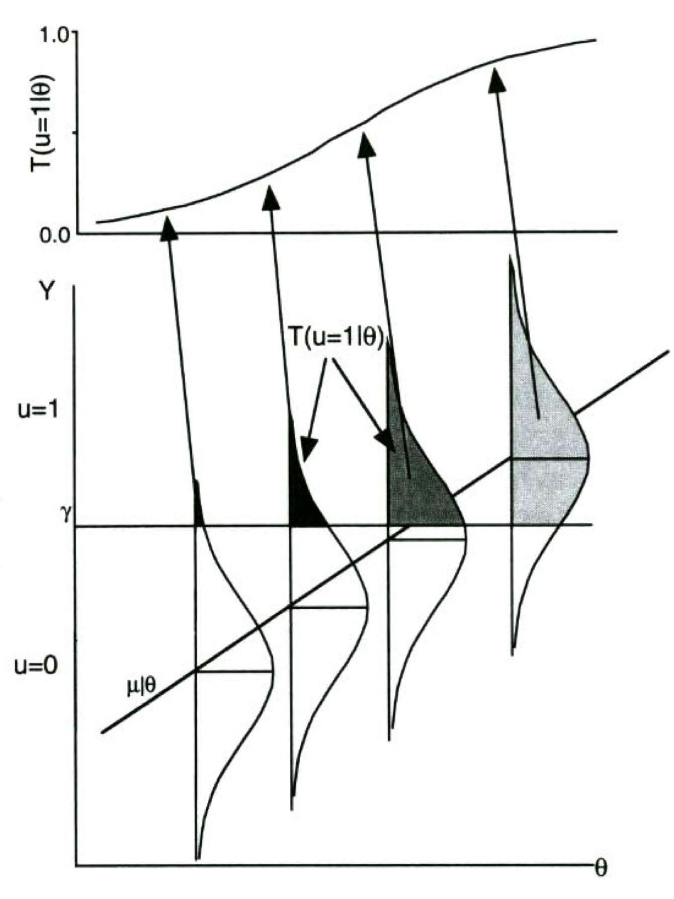
Putting this Together
Correlation (ρ_{i})
Threshold (τ_{i})
Source: Thissen & Orlando (2001), p. 86

Slide 25
Two Parameter Normal Ogive ICC
where
So given the present example if $ρi = 0.7$ and $τi = 1$

Slide 26
Plot of the ICC for this Item in R
theta<-seq(from=-4,to=4,by=.1)
a<-1
b<-1.43
cum2plno<-pnorm(a*(theta-b))
plot(theta, cum2plno, col="black", xlab="", ylab="Cumulative Probability",
type="l",lwd=2, cex=2, main="", cex.axis=.8)

Slide 27
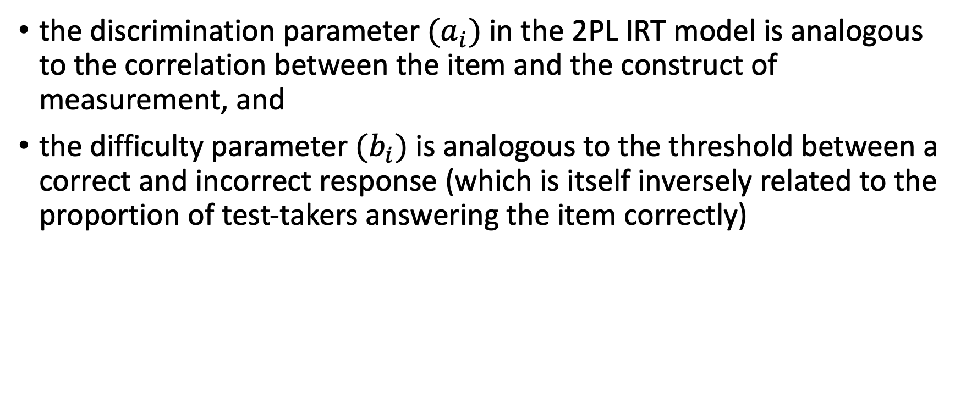
This explains why
the discrimination parameter $(a_{i})$ in the 2PL IRT model is analogous to the correlation between the item and the construct of measurement, and
the difficulty parameter $(b_{i})$ is analogous to the threshold between a correct and incorrect response (which is itself inversely related to the proportion of test-takers answering the item correctly)

Slide 28
From IRT Parameters back to Factor Analytic Parameters
Note: these relationship only hold if theta is normally distributed and there is no guessing on items.
Threshold of item continuum a person needs to be at or above to answer item correctly. Not a parameter of interest in a linear FA model.
Biserial Correlaton between item and test construct. Equivalent to a factor loading in a linear factor analysis model.

Slide 29
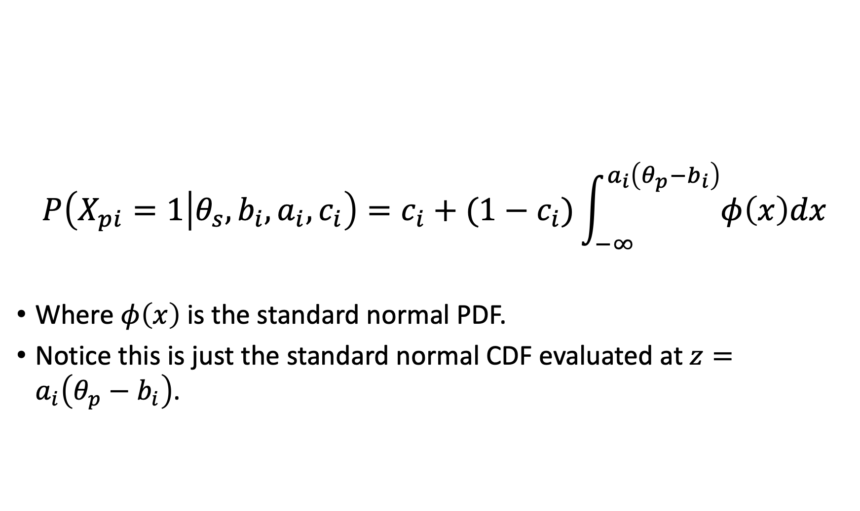
The Three Parameter Normal Ogive Model
$$P\left(X_{pi}=1 | θ_{s}, b_{i},a_{i},c_{i}\right)=c_{i}+(1−c_{i})\int_{−∞}^{a_{i}\left(θ_{p}−b_{i}\right)}{φ\left(x\right)dx}$$
Where $φ\left(x\right)$ is the standard normal PDF.
Notice this is just the standard normal CDF evaluated at $z=a_{i}\left(θ_{p}−b_{i}\right)$.

Slide 30
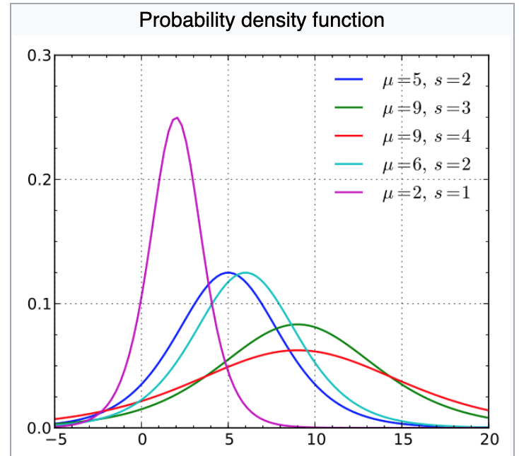
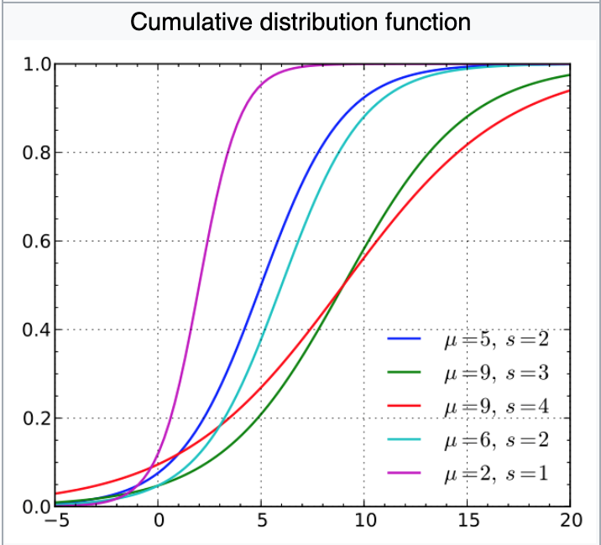
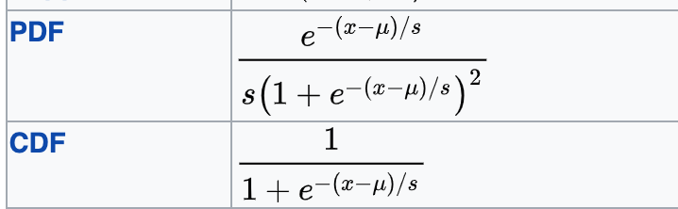
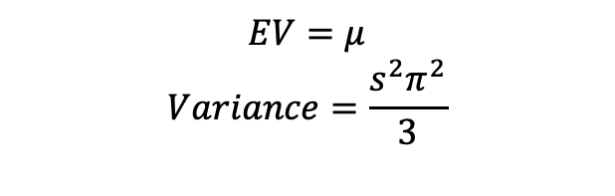
Logistic PDF and CDF
$$EV=μ$$
$$Variance=\frac{s^{2}π^{2}}{3}$$
https://en.wikipedia.org/wiki/Logistic_distribution

Slide 31
Applying the Logistic PDF and CDF in R
ldensities<-dlogis(xseq,location=500,scale=100)
lcumulative<-plogis(xseq, location=500,scale=100)

Slide 32
Logistic CDF as IRF

Slide 33
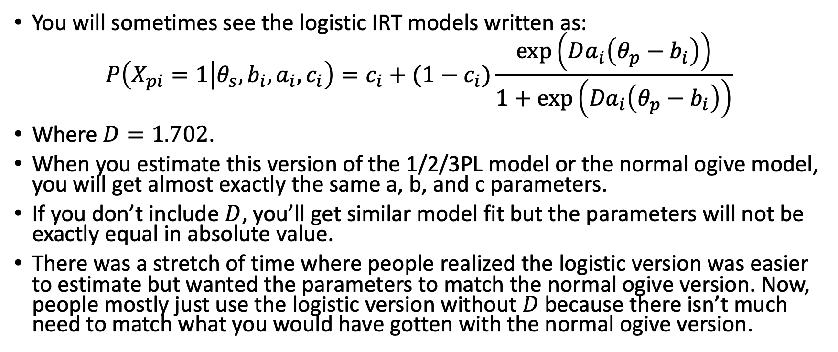
The Logistic vs. Normal Ogive IRT Models
You will sometimes see the logistic IRT models written as:
$$P\left(X_{pi}=1 | θ_{s}, b_{i},a_{i},c_{i}\right)=c_{i}+(1−c_{i})\frac{\exp\left(Da_{i}\left(θ_{p}−b_{i}\right)\right)}{1+\exp\left({Da}_{i}\left(θ_{p}−b_{i}\right)\right)}$$
Where $D=1.702$.
When you estimate this version of the 1/2/3PL model or the normal ogive model, you will get almost exactly the same a, b, and c parameters.
If you don’t include $D$, you’ll get similar model fit but the parameters will not be exactly equal in absolute value.
There was a stretch of time where people realized the logistic version was easier to estimate but wanted the parameters to match the normal ogive version. Now, people mostly just use the logistic version without $D$ because there isn’t much need to match what you would have gotten with the normal ogive version.

Slide 34
Logistic IRT Models

Slide 35
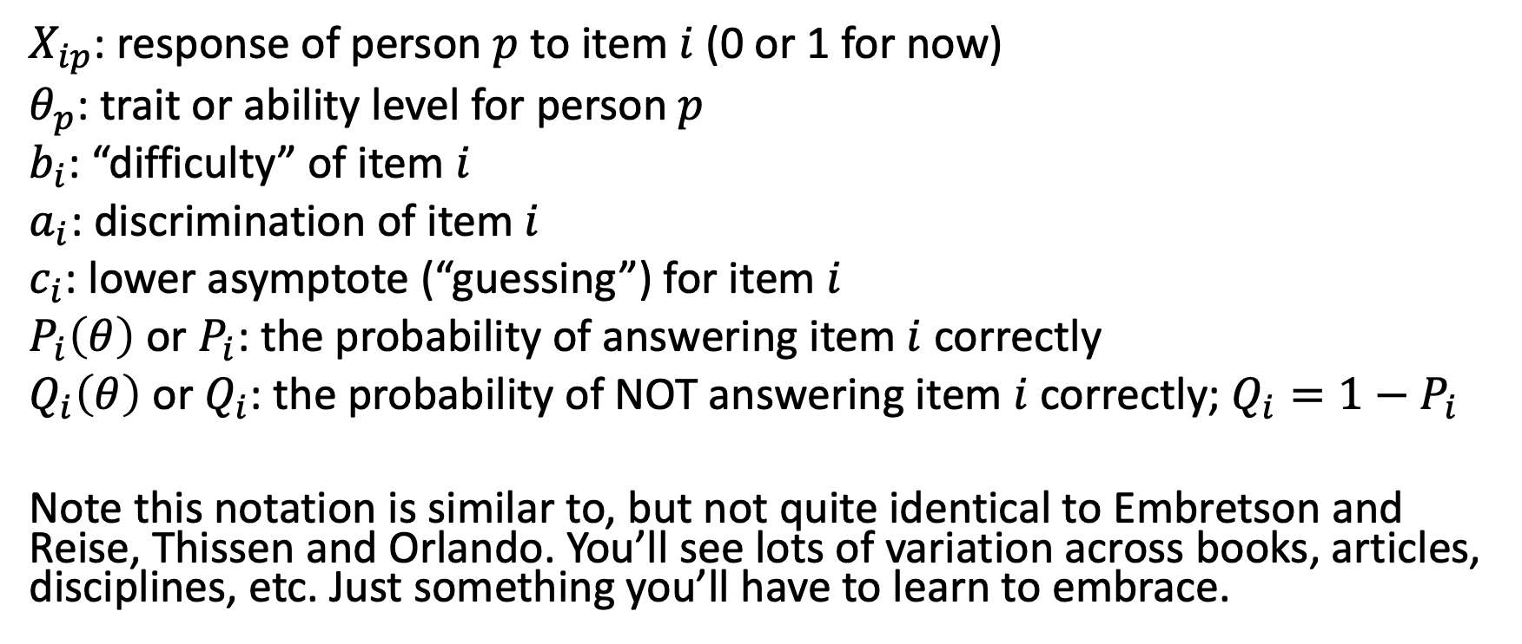
Some Notation
$X_{ip}$: response of person $p$ to item $i$ (0 or 1 for now)
$θ_{p}$: trait or ability level for person $p$
$b_{i}$: “difficulty” of item $i$
$a_{i}$: discrimination of item $i$
$c_{i}$: lower asymptote (“guessing”) for item $i$
$P_{i}\left(θ\right)$ or $P_{i}$: the probability of answering item $i$ correctly
$Q_{i}\left(θ\right)$ or $Q_{i}$: the probability of NOT answering item $i$ correctly; $Q_{i}=1−P_{i}$
Note this notation is similar to, but not quite identical to Embretson and Reise, Thissen and Orlando. You’ll see lots of variation across books, articles, disciplines, etc. Just something you’ll have to learn to embrace.

Slide 36
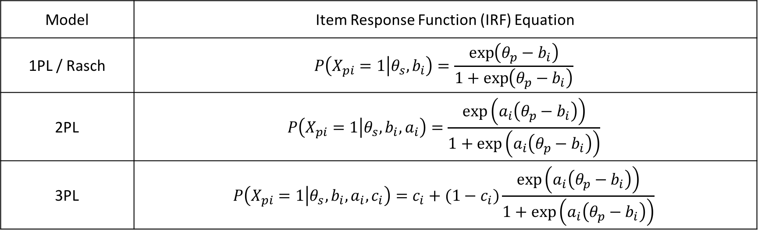
The one, two, and three-parameter logistic IRT models (aka, 1/2/3PL models)
Model | Item Response Function (IRF) Equation
1PL / Rasch | $$P\left(X_{pi}=1 | θ_{s}, b_{i}\right)=\frac{\exp\left(θ_{p}−b_{i}\right)}{1+\exp\left(θ_{p}−b_{i}\right)}$$
2PL | $$P\left(X_{pi}=1 | θ_{s}, b_{i},a_{i}\right)=\frac{\exp\left(a_{i}\left(θ_{p}−b_{i}\right)\right)}{1+\exp\left(a_{i}\left(θ_{p}−b_{i}\right)\right)}$$
3PL | $$P\left(X_{pi}=1 | θ_{s}, b_{i},a_{i},c_{i}\right)=c_{i}+(1−c_{i})\frac{\exp\left(a_{i}\left(θ_{p}−b_{i}\right)\right)}{1+\exp\left(a_{i}\left(θ_{p}−b_{i}\right)\right)}$$
These IRFs describe the probability of answering each item correctly, as a function of some item parameters and a person parameter.

Slide 37
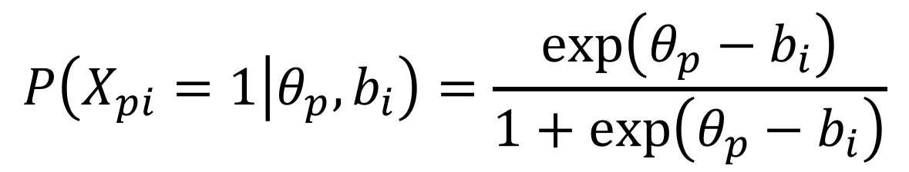
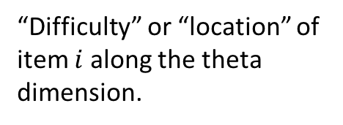
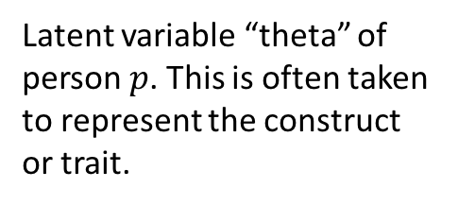
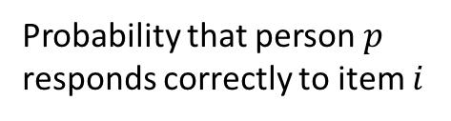
The 1PL Model Item Response Function
This is the logistic function. This describes the shape of the item response function.
Probability that person $p$ responds correctly to item $i$
$$P\left(X_{pi}=1 | θ_{p}, b_{i}\right)=\frac{\exp\left(θ_{p}−b_{i}\right)}{1+\exp\left(θ_{p}−b_{i}\right)}$$
Latent variable “theta” of person $p$. This is often taken to represent the construct or trait.
Taken together, the IRF describes how the probability of a correct (or higher) response varies as a function of the person’s location on the latent variable scale and the item’s location on the latent variable scale.
“Difficulty” or “location” of item $i$ along the theta dimension.

Slide 38
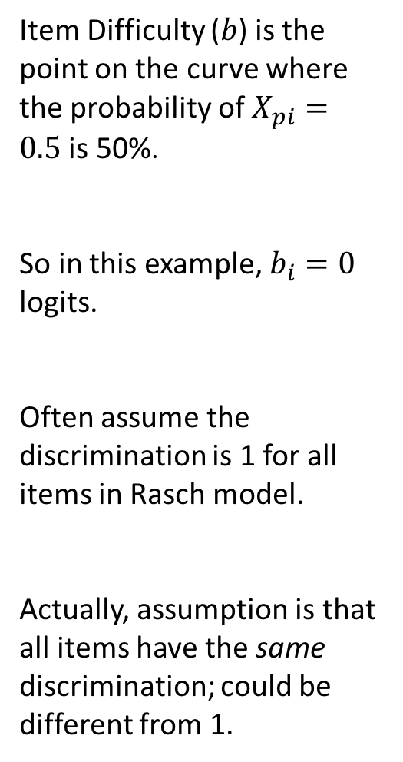
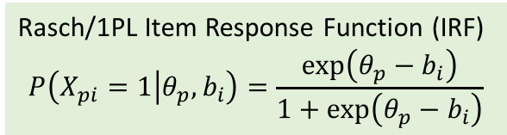
1.0
Rasch/1PL Item Response Function (IRF)
$$P\left(X_{pi}=1 | θ_{p}, b_{i}\right)=\frac{\exp\left(θ_{p}−b_{i}\right)}{1+\exp\left(θ_{p}−b_{i}\right)}$$
Item Difficulty ($b$) is the point on the curve where the probability of $X_{pi}=0.5$ is 50%.
So in this example, $b_{i}=0$ logits.
Often assume the discrimination is 1 for all items in Rasch model.
Actually, assumption is that all items have the same discrimination; could be different from 1.
0.8
0.6
Probability (X_{pi} = 1)
0.4
0.2
0.0
-3
-2
-1
0
1
2
3
Theta (in logits)

Slide 39
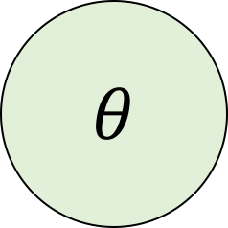
IRT as a “Factor Diagram”
Item 1
Item 2
Item 3
Item 2
Item 3
$$θ$$
Each person has a $θ$ value. Each item has a $b_{i}$ value. These two values determine the probability of a correct response to each item for each person. Based on those probabilities, we then observe either 0 or 1 for each item. You can think of this like a common factor model, but with the IRF instead of a continuous observed item score.

Slide 40
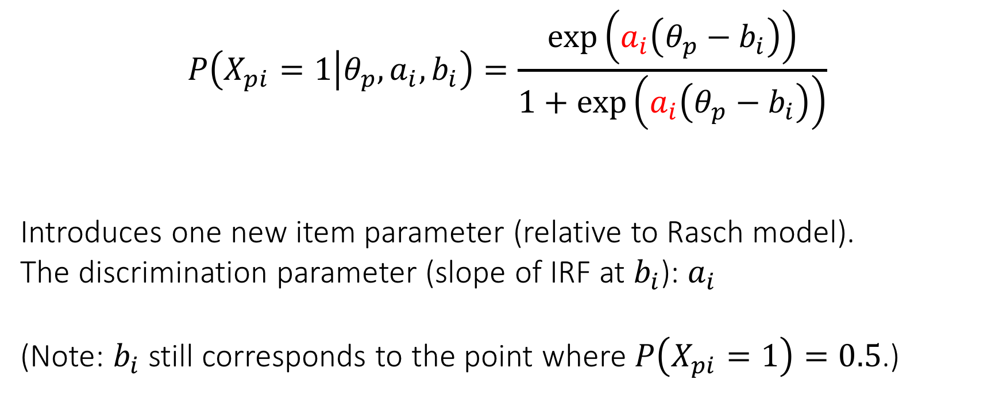
The 2PL Model
$$P\left(X_{pi}=1 | θ_{p}, a_{i}, b_{i}\right)=\frac{\exp\left(a_{i}\left(θ_{p}−b_{i}\right)\right)}{1+\exp\left(a_{i}\left(θ_{p}−b_{i}\right)\right)}$$
Introduces one new item parameter (relative to Rasch model).
The discrimination parameter (slope of IRF at $b_{i}$): $a_{i}$
(Note: $b_{i}$ still corresponds to the point where $P\left(X_{pi}=1\right)=0.5$.)

Slide 41
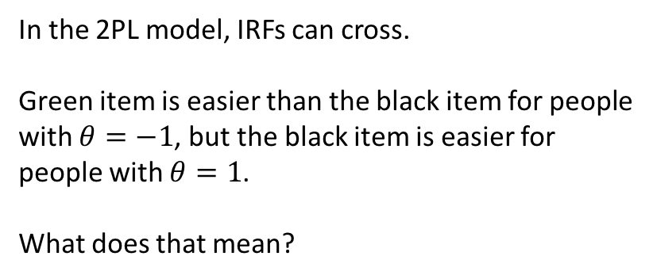
2PL IRFs
In the 2PL model, IRFs can cross.
Green item is easier than the black item for people with $θ=−1$, but the black item is easier for people with $θ=1$.
What does that mean?

Slide 42
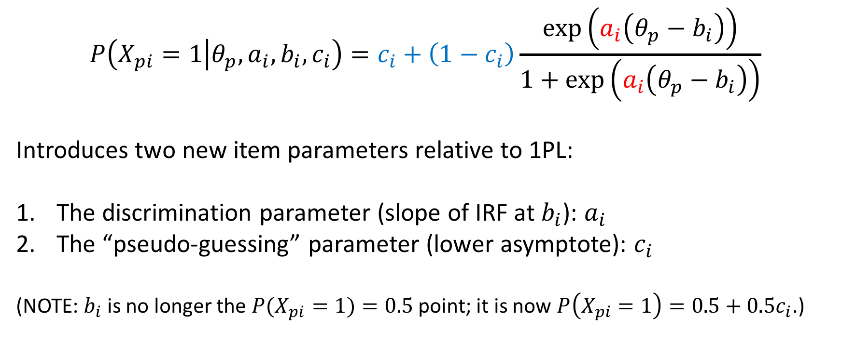
The 3PL Model
$$P\left(X_{pi}=1 | θ_{p}, a_{i}, b_{i}, c_{i}\right)=c_{i}+\left(1−c_{i}\right)\frac{\exp\left(a_{i}\left(θ_{p}−b_{i}\right)\right)}{1+\exp\left(a_{i}\left(θ_{p}−b_{i}\right)\right)}$$
Introduces two new item parameters relative to 1PL:
The discrimination parameter (slope of IRF at $b_{i}$): $a_{i}$
The “pseudo-guessing” parameter (lower asymptote): $c_{i}$
(NOTE: $b_{i}$ is no longer the $P(X_{pi}=1)=0.5$ point; it is now $P\left(X_{pi}=1\right)=0.5+0.5c_{i}$.)
Notes:
Slope is maximal at b.

Slide 43
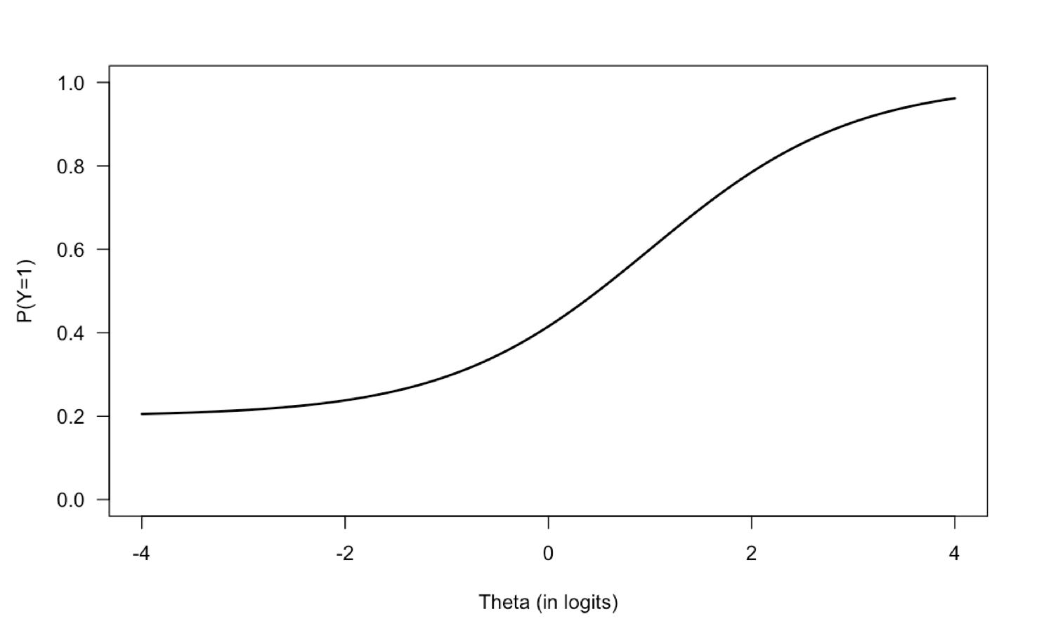
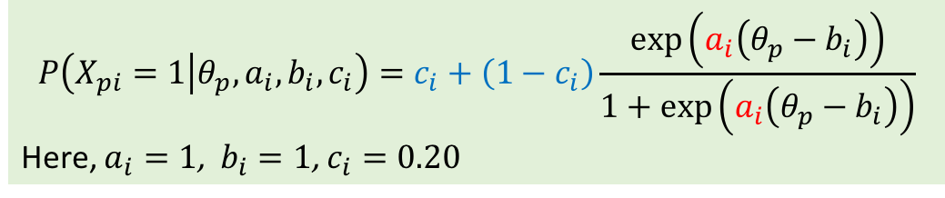
The 3PL IRF
$$P\left(X_{pi}=1 | θ_{p}, a_{i}, b_{i}, c_{i}\right)=c_{i}+\left(1−c_{i}\right)\frac{\exp\left(a_{i}\left(θ_{p}−b_{i}\right)\right)}{1+\exp\left(a_{i}\left(θ_{p}−b_{i}\right)\right)}$$
Here, $a_{i}=1$, $b_{i}=1$, $c_{i}=0.20$
Item discrimination (slope)
Item “Location”
Pseudo-Guessing Parameter

Slide 44
Comparing the IRFs
1PL/Rasch IRFs
2PL IRFs
3PL IRFs

Slide 45
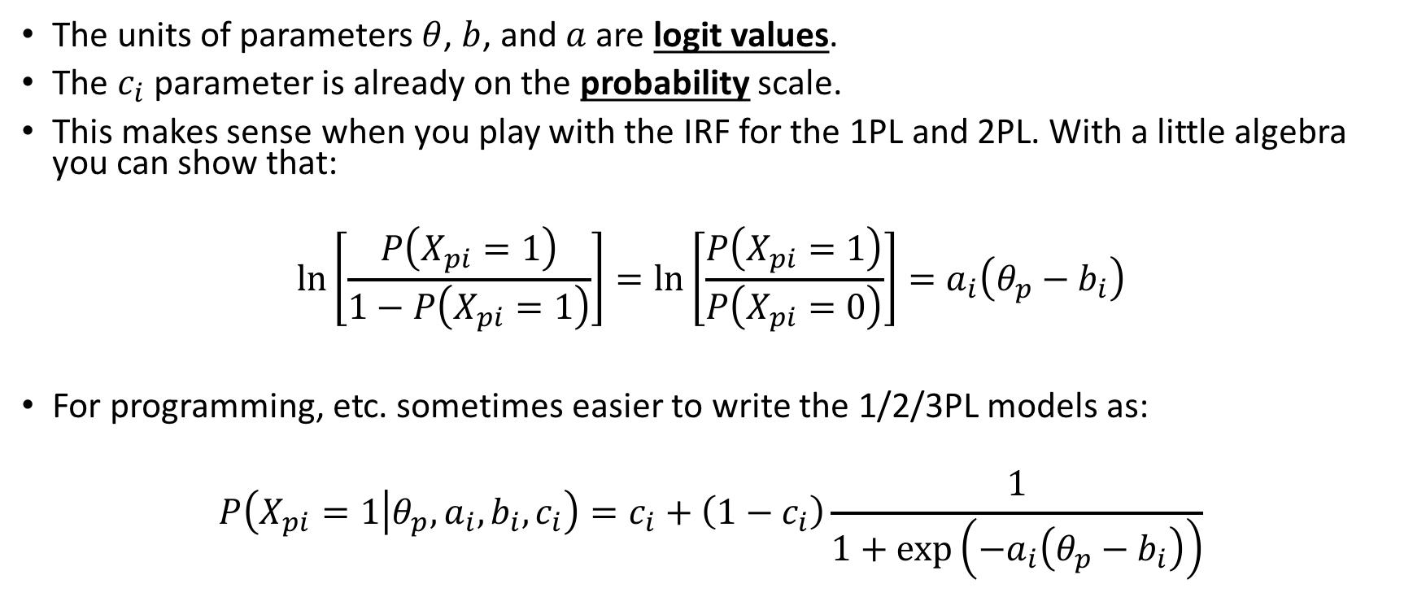
Logits and Other Forms
The units of parameters $θ$, $b$, and $a$ are logit values.
The $c_{i}$ parameter is already on the probability scale.
This makes sense when you play with the IRF for the 1PL and 2PL. With a little algebra you can show that:
$$\ln\left[\frac{P\left(X_{pi}=1\right)}{1−P\left(X_{pi}=1\right)}\right]=\ln\left[\frac{P\left(X_{pi}=1\right)}{P\left(X_{pi}=0\right)}\right]=a_{i}\left(θ_{p}−b_{i}\right)$$
For programming, etc. sometimes easier to write the 1/2/3PL models as:
$$P\left(X_{pi}=1 | θ_{p}, a_{i}, b_{i}, c_{i}\right)=c_{i}+\left(1−c_{i}\right)\frac{1}{1+\exp\left(−a_{i}\left(θ_{p}−b_{i}\right)\right)}$$

Slide 46
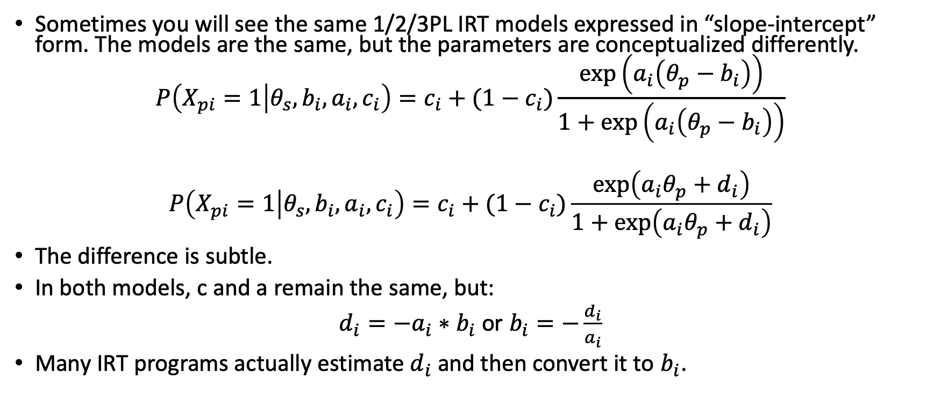
The “Slope-Intercept” Form
Sometimes you will see the same 1/2/3PL IRT models expressed in “slope-intercept” form. The models are the same, but the parameters are conceptualized differently.
$$P\left(X_{pi}=1 | θ_{s}, b_{i},a_{i},c_{i}\right)=c_{i}+(1−c_{i})\frac{\exp\left(a_{i}\left(θ_{p}−b_{i}\right)\right)}{1+\exp\left(a_{i}\left(θ_{p}−b_{i}\right)\right)}$$
$$P\left(X_{pi}=1 | θ_{s}, b_{i},a_{i},c_{i}\right)=c_{i}+(1−c_{i})\frac{\exp\left(a_{i}θ_{p}+d_{i}\right)}{1+\exp\left(a_{i}θ_{p}+d_{i}\right)}$$
The difference is subtle.
In both models, c and a remain the same, but:
$d_{i}=−a_{i}∗b_{i}$ or $b_{i}=−\frac{d_{i}}{a_{i}}$
Many IRT programs actually estimate $d_{i}$ and then convert it to $b_{i}$.

Slide 47
IRT Model Properties and Assumptions

Slide 48
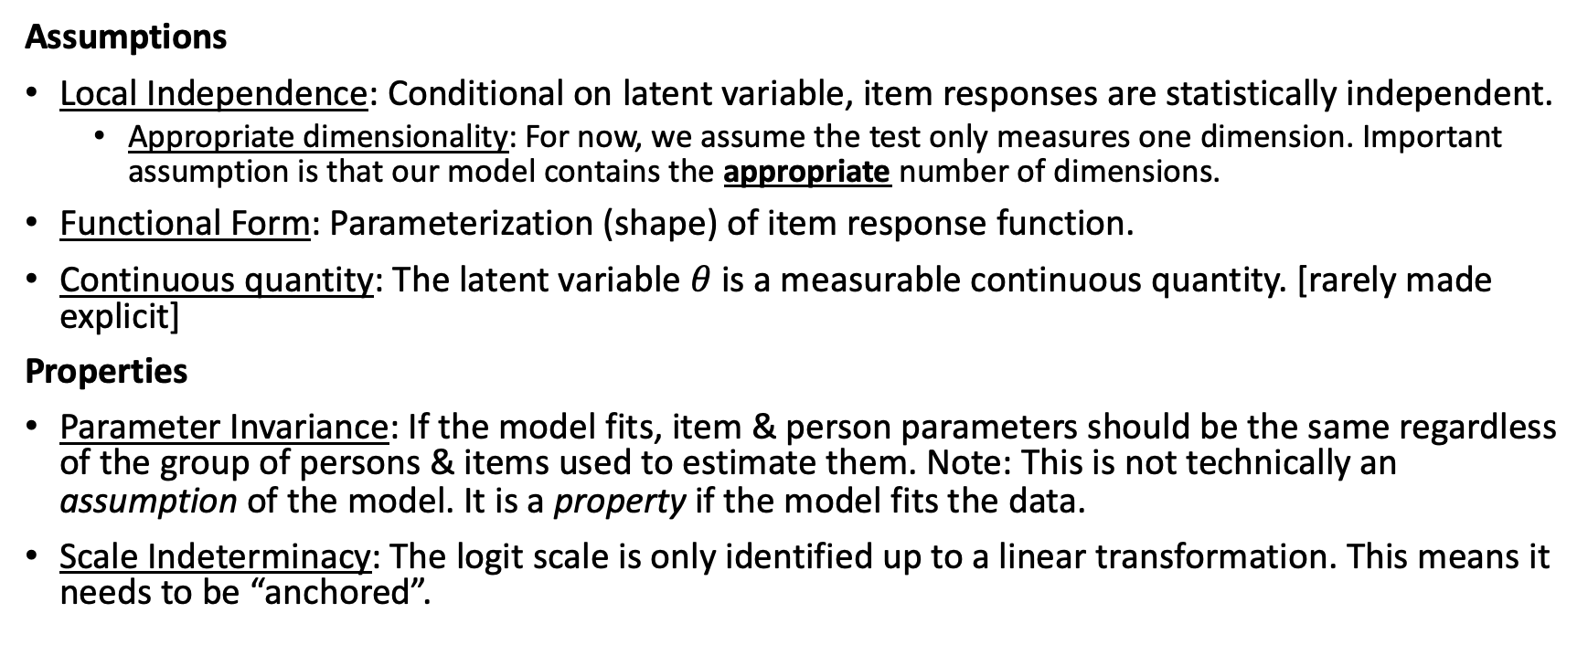
IRT Model Assumptions and Properties
Assumptions
Local Independence: Conditional on latent variable, item responses are statistically independent.
Appropriate dimensionality: For now, we assume the test only measures one dimension. Important assumption is that our model contains the appropriate number of dimensions.
Functional Form: Parameterization (shape) of item response function.
Continuous quantity: The latent variable $θ$ is a measurable continuous quantity. [rarely made explicit]
Properties
Parameter Invariance: If the model fits, item & person parameters should be the same regardless of the group of persons & items used to estimate them. Note: This is not technically an assumption of the model. It is a property if the model fits the data.
Scale Indeterminacy: The logit scale is only identified up to a linear transformation. This means it needs to be “anchored”.

Slide 49
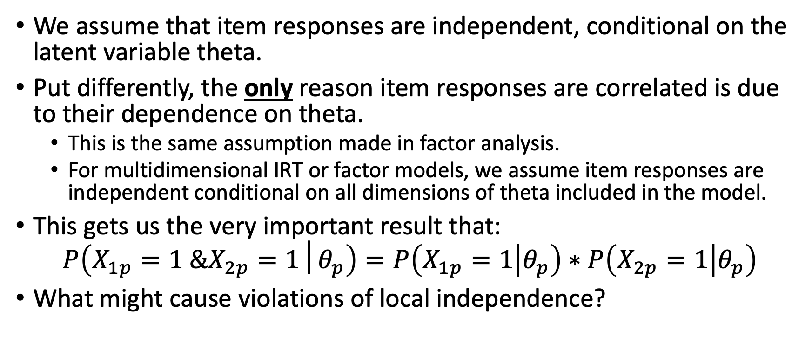
Assumption of Local Independence
We assume that item responses are independent, conditional on the latent variable theta.
Put differently, the only reason item responses are correlated is due to their dependence on theta.
This is the same assumption made in factor analysis.
For multidimensional IRT or factor models, we assume item responses are independent conditional on all dimensions of theta included in the model.
This gets us the very important result that:
$$P\left(X_{1p}=1 \&X_{2p}=1│θ_{p}\right)=P\left(X_{1p}=1 | θ_{p}\right)∗P\left(X_{2p}=1 | θ_{p}\right)$$
What might cause violations of local independence?

Slide 50
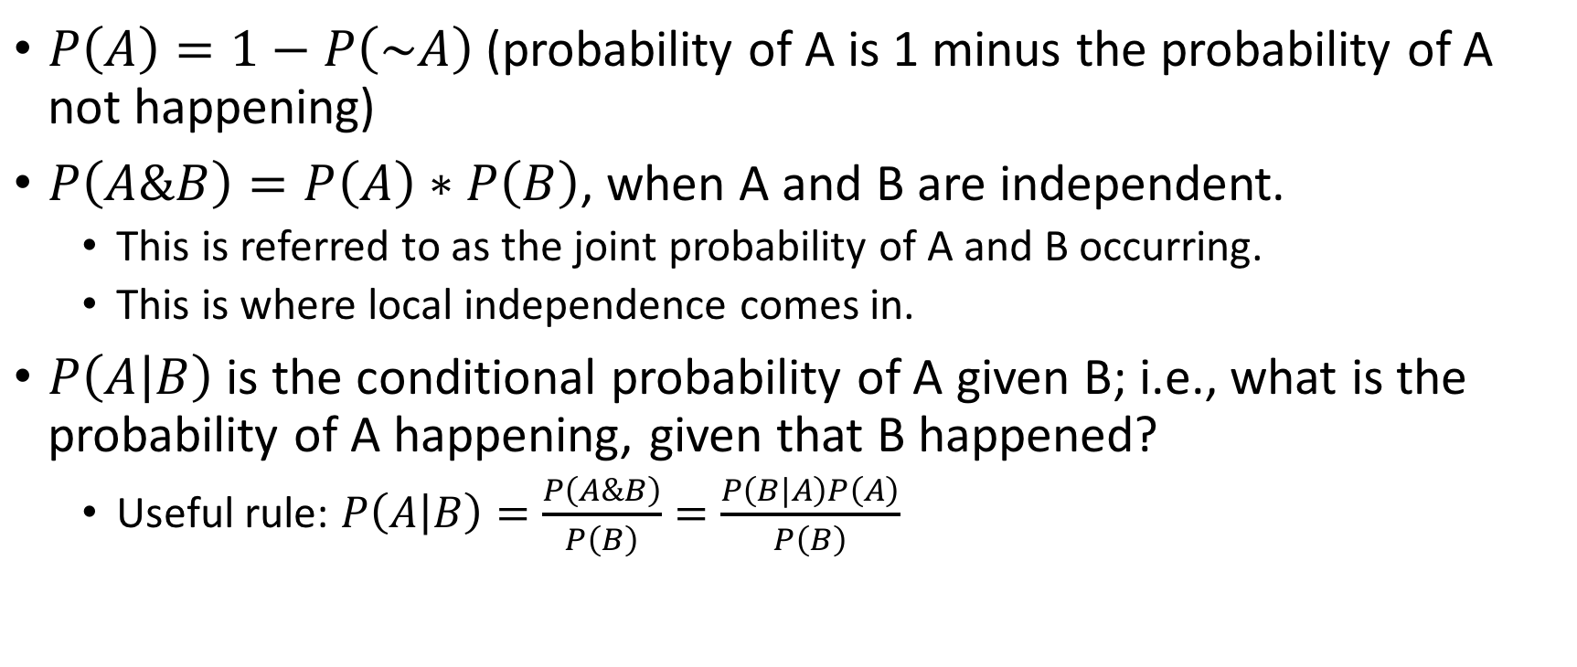
Quick Aside: Useful Probability Rules
$P\left(A\right)=1−P\left(\sim A\right)$ (probability of A is 1 minus the probability of A not happening)
$P\left(A\&B\right)=P\left(A\right)∗P\left(B\right)$, when A and B are independent.
This is referred to as the joint probability of A and B occurring.
This is where local independence comes in.
$P\left(A | B\right)$ is the conditional probability of A given B; i.e., what is the probability of A happening, given that B happened?
Useful rule: $P\left(A | B\right)=\frac{P\left(A\&B\right)}{P\left(B\right)}=\frac{P\left(B|A\right)P\left(A\right)}{P\left(B\right)}$

Slide 51
Dimensionality
If a test is multidimensional and we fit only a single latent variable, could cause local item dependence.
Note that the dimensionality refers to the number of latent variables needed to model the response data.
This may or may not correspond to the hypothesized dimensionality of the theoretical construct.
Most IRT models used in practice are unidimensional.

Slide 52
Assumption of ICC Form
We assume that the probability of correct responses follows the logistic form or normal ogive shown earlier.
Key characteristics are:
Monotonically increasing probability as function of (one) theta.
S-shape of the logistic (or normal ogive) curve.
Can describe this with the a/b/c parameters.
Note that there are IRT models with more parameters.

Slide 53
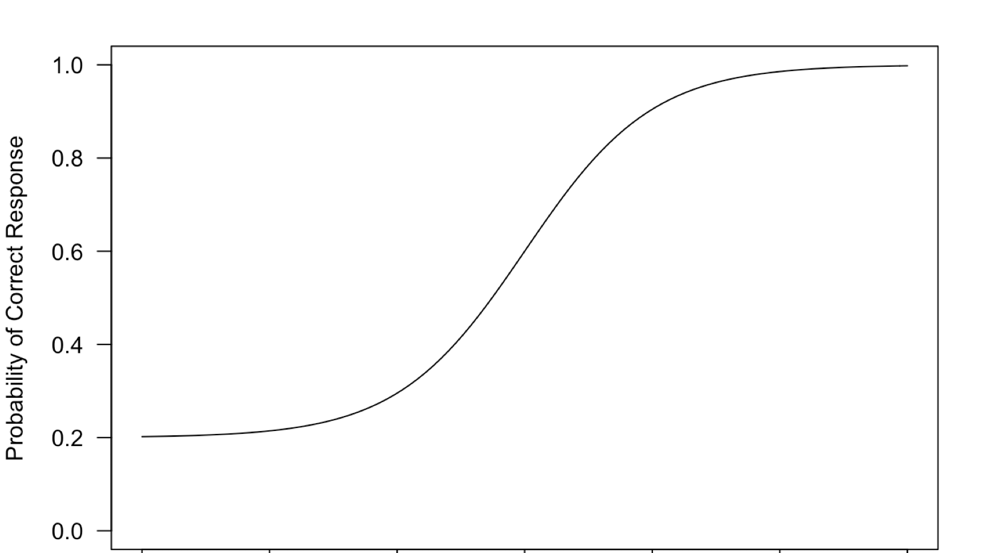
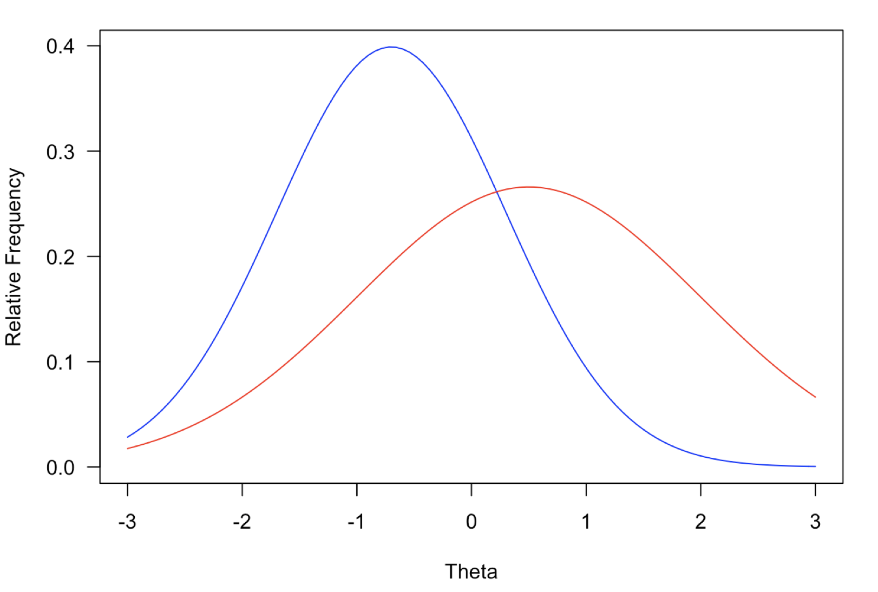
Parameter Invariance
If the model fits the data, item parameter estimates should be the same regardless of group used to estimate data.
We should get same a/b/c parameters from either the red or blue group.
If using CTT, we would expect very different item p-values from these groups.
A strong assumption, but can be checked empirically.
Same assumption made, e.g., in linear regression – we assume the slope and intercept are same regardless of group used to estimate the model.

Slide 54
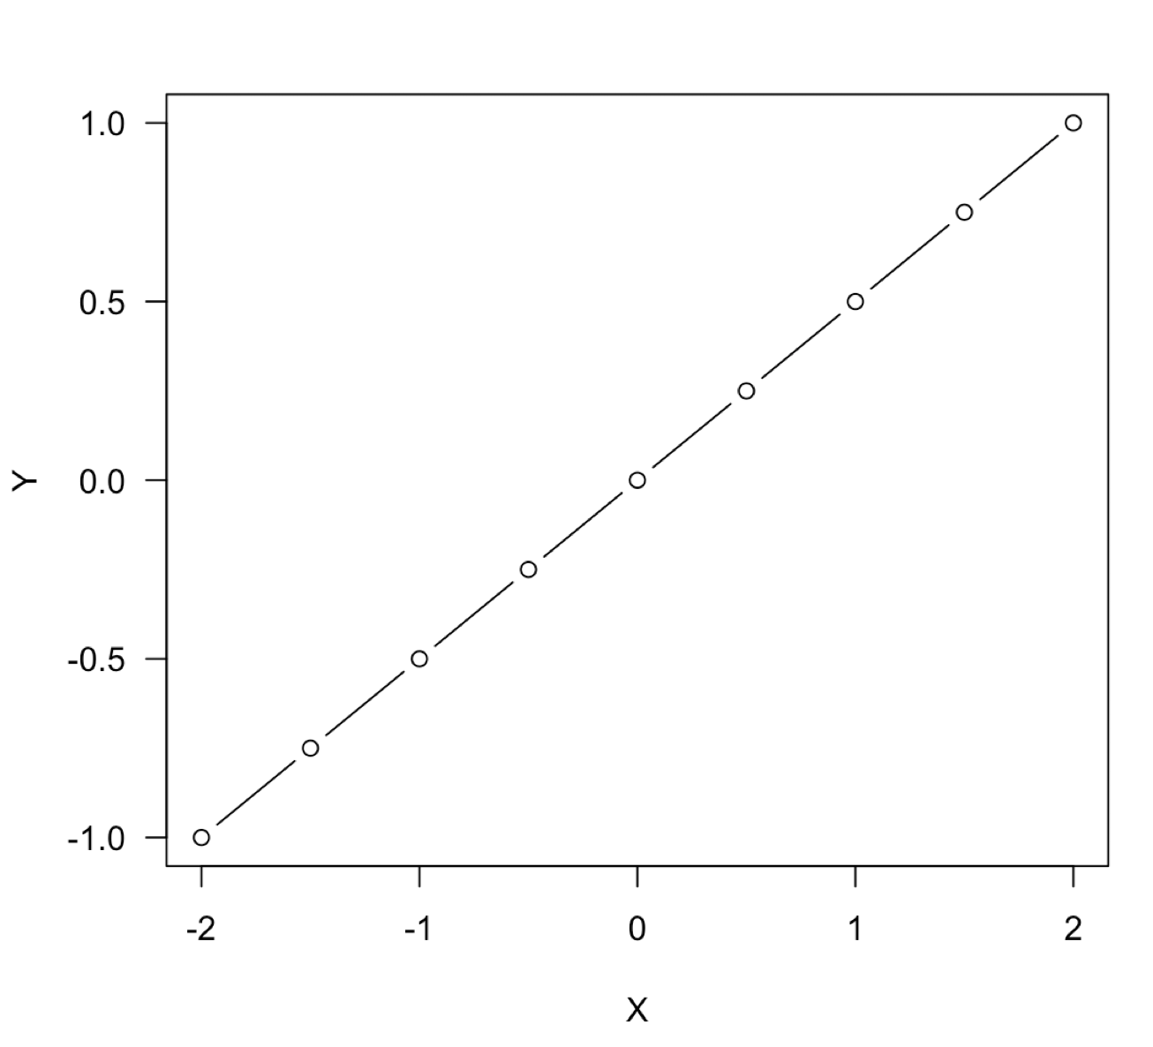
Parameter Invariance Analogy: Linear Regression
In this example, the continuous variables X and Y have been standardized.
We have values of X and Y for a complete population of interest.
Each point on the plot represents the expected value of Y given a specific value of X.
The corresponding regression line, which fits perfectly in this case, has a slope parameter that is invariant as a function of X.
I get the same slope estimate at both the blue points and red points. It doesn’t matter which section of X and Y data I observe.

Slide 55
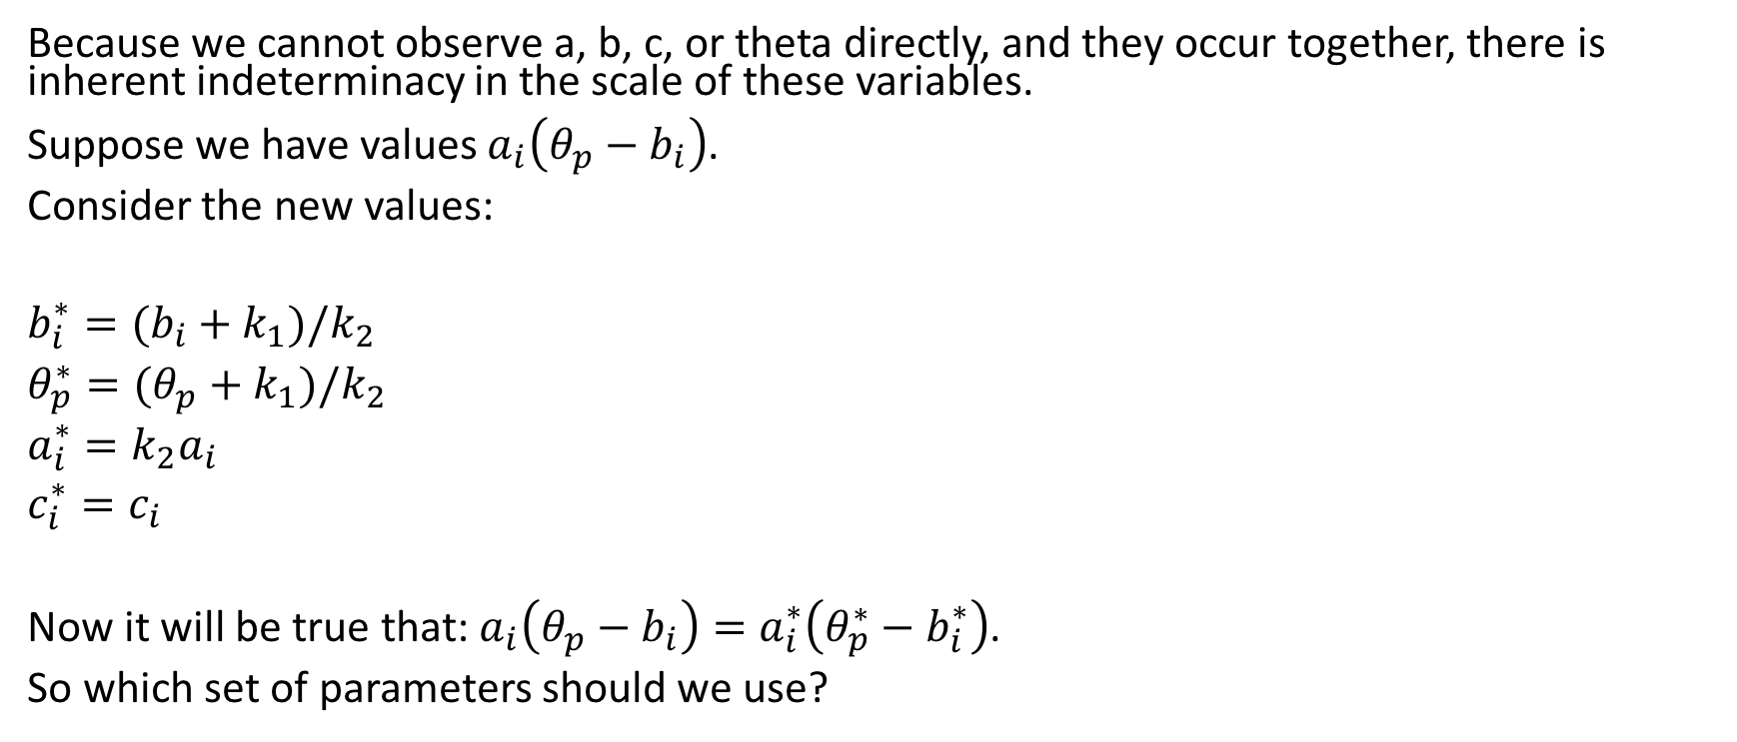
Scale Indeterminacy
Because we cannot observe a, b, c, or theta directly, and they occur together, there is inherent indeterminacy in the scale of these variables.
Suppose we have values $a_{i}\left(θ_{p}−b_{i}\right)$.
Consider the new values:
$b_{i}^{∗}=(b_{i}+k_{1})/k_{2}$
$θ_{p}^{∗}=(θ_{p}+k_{1})/k_{2}$
$a_{i}^{∗}=k_{2}a_{i}$
$c_{i}^{∗}=c_{i}$
Now it will be true that: $a_{i}\left(θ_{p}−b_{i}\right)=a_{i}^{∗}\left(θ_{p}^{∗}−b_{i}^{∗}\right)$.
So which set of parameters should we use?

Slide 56
Resolving Scale Indeterminacy
There are two main approaches.
Item-Side Anchoring
Place constraints on the item parameters (e.g., average item difficulty is 0).
Freely estimate the theta distribution.
More common in Rasch modeling and in Europe.
Person-Side Anchoring
Fix distribution of theta to have mean of 0 and SD of 1.
Freely estimate the item parameters.
More common in US and in achievement testing.
We will return to this when we learn how to estimate the parameters.

Slide 57
Example using the MIRT Package

Slide 58
The mirt package in R
Written by Phillip Chalmers
Incredibly flexible package
Fits pretty much all the most commonly used IRT models for both dichotomous and polytomous items
Also fits most of the multidimensional extensions of these models
Other key extensions: models for multiple “groups”, inclusion of item and person predictor variables.
I’ve created an mirt folder in Canvas that includes a lot of resources, but I would hold off on reading Chalmers (2012) in the Journal of Statistical Software until we have had readings and presentations on parameter estimation.

Slide 59
Let’s use mirt to specify and estimate the 1/2/3PL Models with our Form A Data
Go to “Part 2” of in the file “lb_irt_020220.R”
Makes use of the mirt() package in R.

Slide 60
More Practice

Slide 61
Practice with IRFs and Probabilities
item | a | b | c
1 | 1 | -1.5 | 0.2
2 | 1 | 0 | 0.2
3 | 2 | 0 | 0.3
Refer to Excel document “three_item_test.xlsx”.
Do the following:
Compare the difficulty of item 1 vs. 2.
Compare the difficulty of item 2 vs 3.
Calculate the probability of each of these response vectors for the given theta values:
Theta | 000 | 010 | 111
-4.0
-1.1
0
1.6

Slide 62
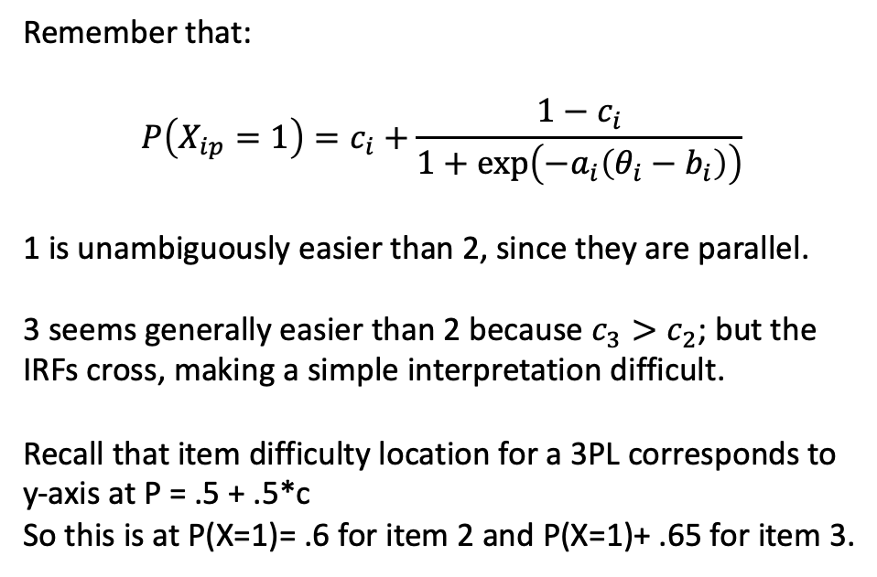
Theta | 000 | 010 | 111
-4.0 | 0.406 | 0.111 | 0.017
-1.1 | 0.126 | 0.084 | 0.095
0 | 0.024 | 0.037 | 0.298
1.6 | 0.000 | 0.001 | 0.802
Remember that:
$$P\left(X_{ip}=1\right)=c_{i}+\frac{1−c_{i}}{1+\exp\left(−a_{i}\left(θ_{i}−b_{i}\right)\right)}$$
1 is unambiguously easier than 2, since they are parallel.
3 seems generally easier than 2 because $c_{3}>c_{2}$; but the IRFs cross, making a simple interpretation difficult.
Recall that item difficulty location for a 3PL corresponds to y-axis at P = .5 + .5*c
So this is at P(X=1)= .6 for item 2 and P(X=1)+ .65 for item 3.
item | a | b | c
1 | 1 | -1.5 | 0.2
2 | 1 | 0 | 0.2
3 | 2 | 0 | 0.3

Slide 63
Test Characteristic Curves

Slide 64
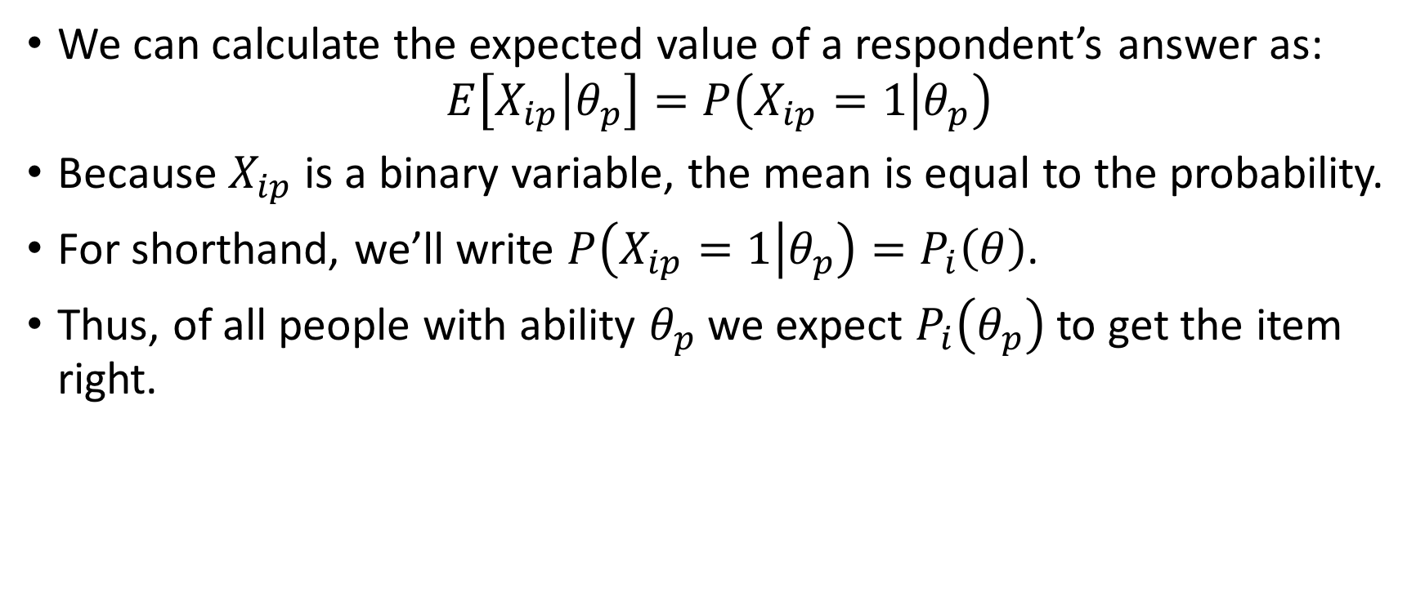
Expected Item Response
We can calculate the expected value of a respondent’s answer as:
$$E\left[X_{ip} | θ_{p}\right]=P\left(X_{ip}=1 | θ_{p}\right)$$
Because $X_{ip}$ is a binary variable, the mean is equal to the probability.
For shorthand, we’ll write $P\left(X_{ip}=1 | θ_{p}\right)=P_{i}\left(θ\right)$.
Thus, of all people with ability $θ_{p}$ we expect $P_{i}\left(θ_{p}\right)$ to get the item right.

Slide 65
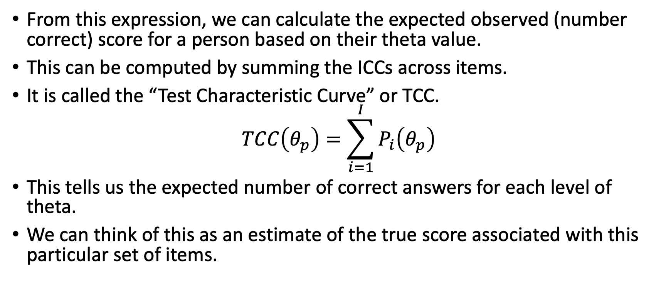
Expected Test Score
From this expression, we can calculate the expected observed (number correct) score for a person based on their theta value.
This can be computed by summing the ICCs across items.
It is called the “Test Characteristic Curve” or TCC.
$$TCC\left(θ_{p}\right)=\sum_{i=1}^{I}{P_{i}\left(θ_{p}\right)}$$
This tells us the expected number of correct answers for each level of theta.
We can think of this as an estimate of the true score associated with this particular set of items.

Slide 66

TCC for the three_item_test.xlsx Data
We can calculate the TCC as the sum of the item $P_{i}$ values at each value of $θ$.

Slide 67
Test and Item Information

Slide 68
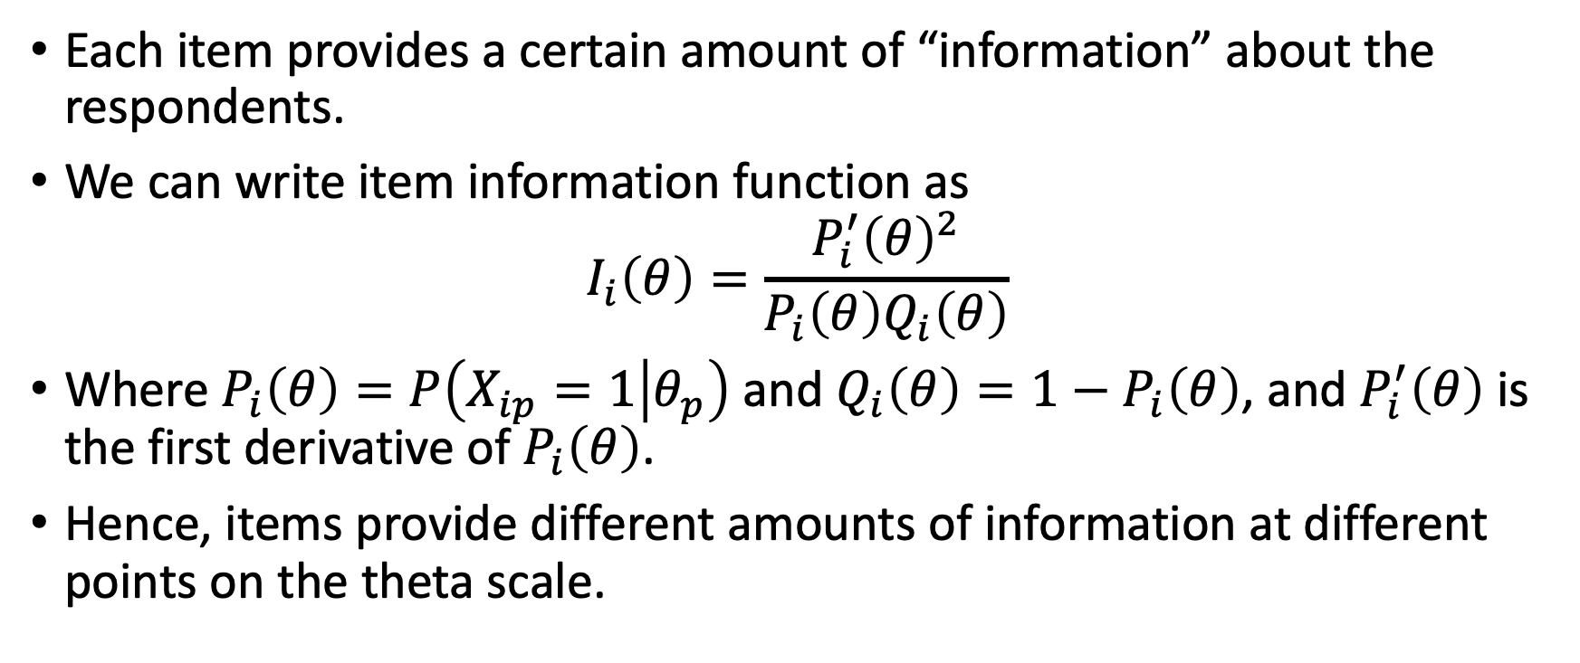
Item Information
Each item provides a certain amount of “information” about the respondents.
We can write item information function as
$$I_{i}\left(θ\right)=\frac{P_{i}^{′}{\left(θ\right)}^{2}}{P_{i}\left(θ\right)Q_{i}\left(θ\right)}$$
Where $P_{i}\left(θ\right)=P\left(X_{ip}=1 | θ_{p}\right)$ and $Q_{i}\left(θ\right)=1−P_{i}\left(θ\right)$, and $P_{i}^{′}\left(θ\right)$ is the first derivative of $P_{i}\left(θ\right)$.
Hence, items provide different amounts of information at different points on the theta scale.

Slide 69
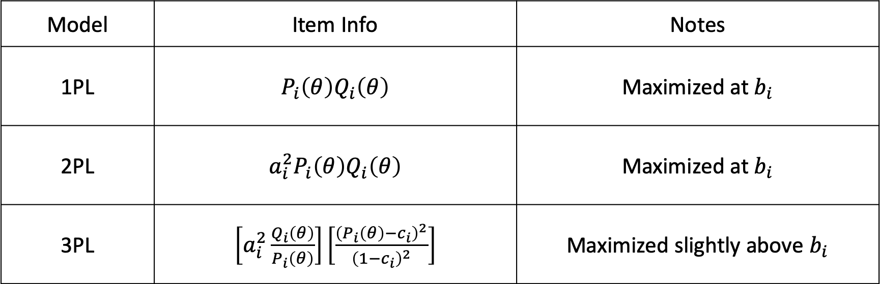
Item Information Functions
Model | Item Info | Notes
1PL | $P_{i}\left(θ\right)Q_{i}\left(θ\right)$ | Maximized at $b_{i}$
2PL | $a_{i}^{2}P_{i}\left(θ\right)Q_{i}\left(θ\right)$ | Maximized at $b_{i}$
3PL | $\left[a_{i}^{2}\frac{Q_{i}\left(θ\right)}{P_{i}\left(θ\right)}\right]\left[\frac{{\left(P_{i}\left(θ\right)−c_{i}\right)}^{2}}{{\left(1−c_{i}\right)}^{2}}\right]$ | Maximized slightly above $b_{i}$

Slide 70
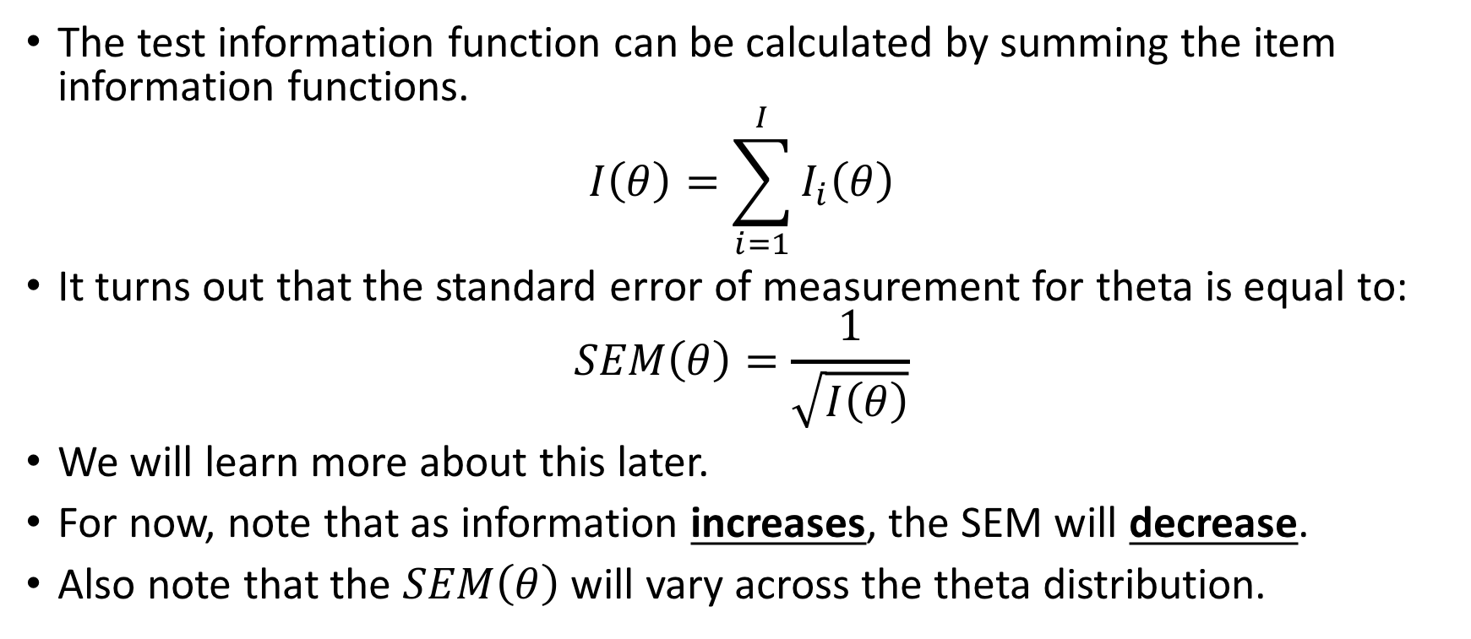
The Test Information Function
The test information function can be calculated by summing the item information functions.
$$I\left(θ\right)=\sum_{i=1}^{I}{I_{i}\left(θ\right)}$$
It turns out that the standard error of measurement for theta is equal to:
$$SEM\left(θ\right)=\frac{1}{\sqrt{I\left(θ\right)}}$$
We will learn more about this later.
For now, note that as information increases, the SEM will decrease.
Also note that the $SEM\left(θ\right)$ will vary across the theta distribution.

Slide 71
Item and Test Info for the three-item-test

Slide 72
Using Test and Item Information Practically
Item information and test information are especially useful for constructing tests.
Can use item information to predict SEM of theta scores.
Can selectively increase information at different points in the theta distribution.

